Slide 1

OLM Application
Heuristic Evaluation

Slide 2
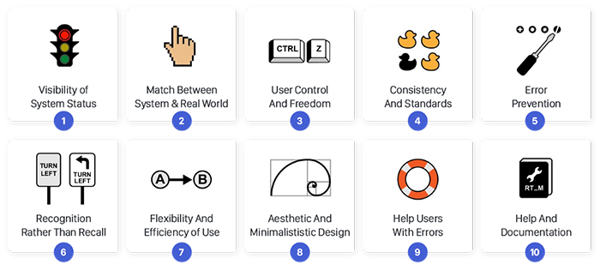
Theory used for Evaluation
OLM Application
Heuristics for User Interface Design
Visibility of system status
Match between system and the real world
User control and freedom
Consistency and standards
Error prevention
Recognition rather than recall
Flexibility and efficiency of use
Aesthetic and minimalist design
Help users recognize, diagnose, and recover from errors
Help and documentation

Slide 3
Key Tasks to be worked based on screens
Landing page (Insights page)
Loss Configuration
Event Classification Configuration
Root cause Configuration

Slide 4
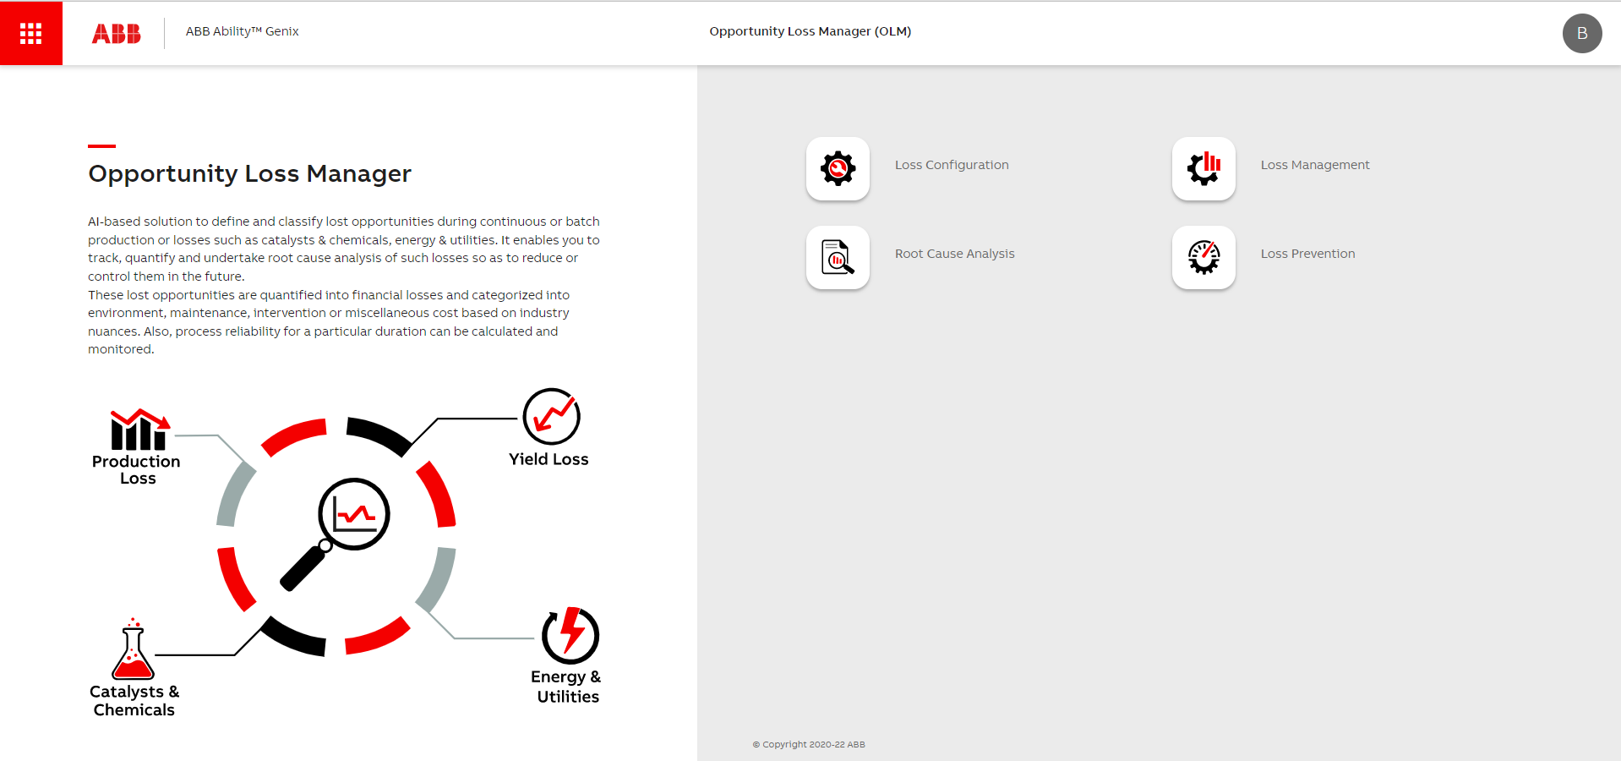
Landing Page
Consistency and standards
Issues:
There is home but user lands in ‘main page’ by default. As extra step for use go into landing page.
Suggestion:
User should land on insights page directly when they click home button land on insights page module.

Slide 5
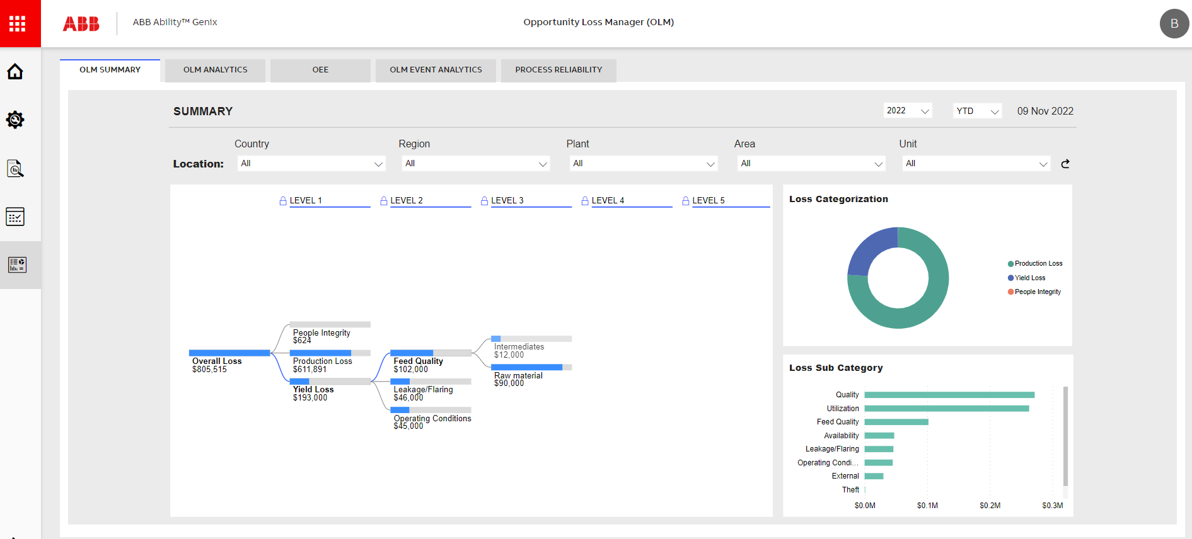
Insights page: OLM summary
Visibility of system status
Consistency and standards
Issues:
1. User need to allocate location in each tab section when we switch tabs location get reset.
2. Date selection and date text is separate. 3. Too many tab for insights page.
Suggestion:
Location allocation needs to be in global level selected once .
Select of date or year should be on date itself or add datepicker to it.
Single insights landing page combining of all tab information remove irrelevant information.
Add more KPI information on top of page to understand imp info at glance and on click show details information.

Slide 6
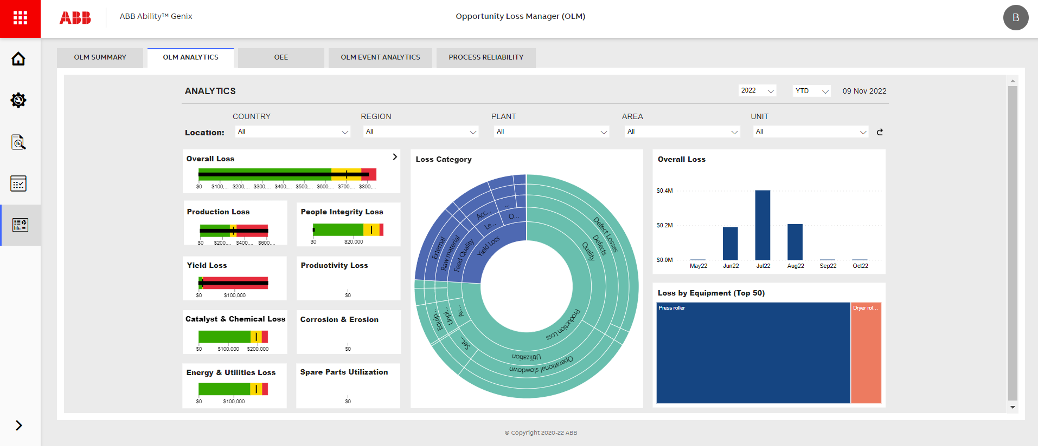
Insights page: OLM Analytics
Visibility of system status
Consistency and standards
Issues:
1. Global location selection is needed
2. Loss category data is too crowded need proper graph to represent date
3. Most of titles are same need to club relevant information add tabs io
Suggestion:
Location allocation needs to be in global level selected once .
Select of date or year should be on date itself or add datepicker to it.
Single insights landing page combining of all tab information remove irrelevant information.
Add more KPI information on top of page to understand imp info at glance and on click show details information.

Slide 7
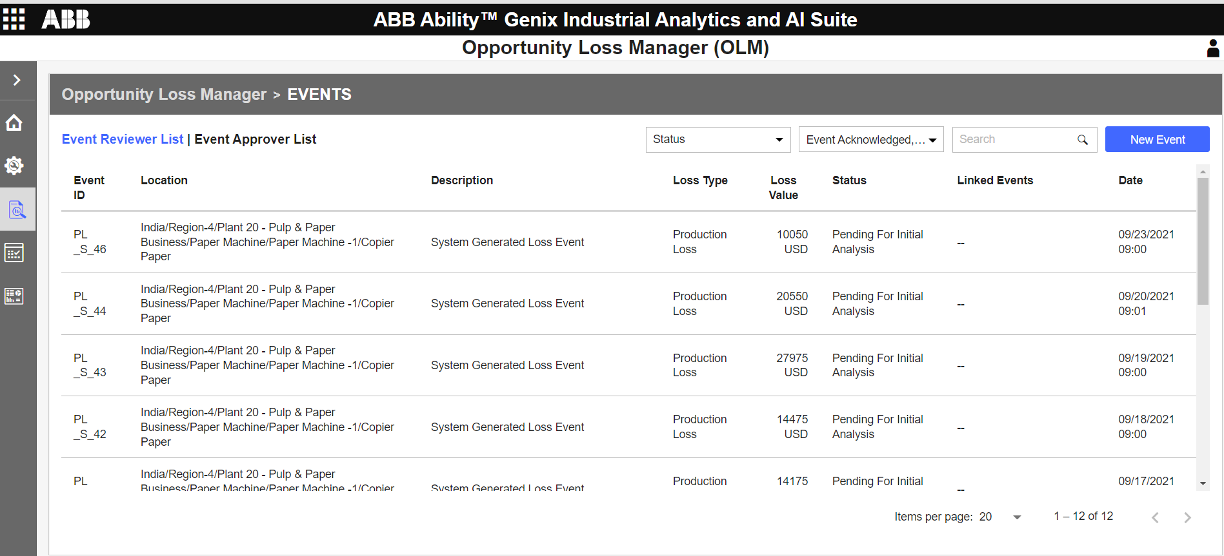
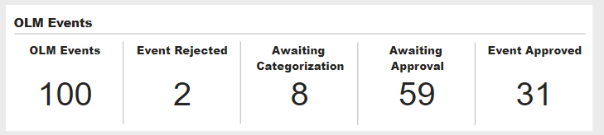
Loss management: Event Page
Visibility of system status
Consistency and standards
Issues:
1. Reviewer and Approver need redesign.
2. Table content need to be redesigns looks crowded
3. Filter looks like for page level
4. Create event click event should be in proper place
5. Event id detail click is not recognizable
Suggestion:
KPI for Event can be show here and details list of
Details drill down of OLM events current not available can show listing.
Event listing of reviewer and approver tab design from arcadia
Status & event Filter needs redesign
Detail event content can be brought upfront can be shown in split section

Slide 8
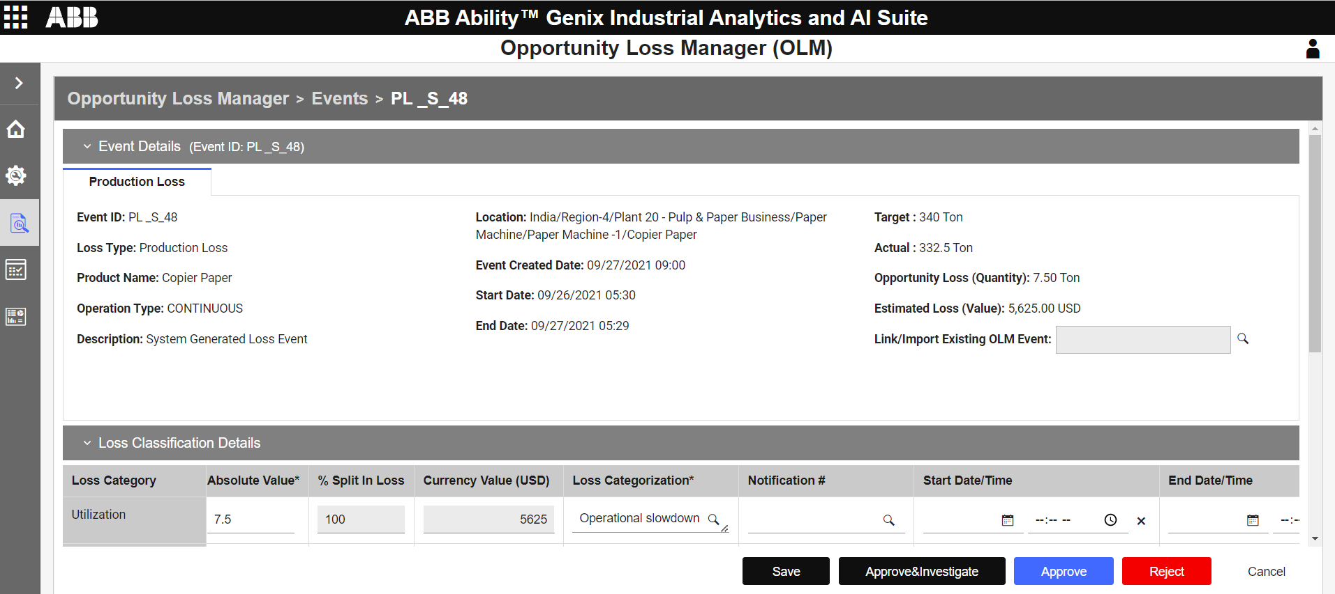
Loss management: Event details
Visibility of system status
Consistency and standards
Issues:
Proper breadcrumb and No back option
Event details list too big to read
Loss calculation table is too big and horizontal scroll
Too many footer button events
Suggestion:
Page level breadcrumb need to implemented
Event detail parameters and linking need to redesign
Page needs complete redesign

Slide 9
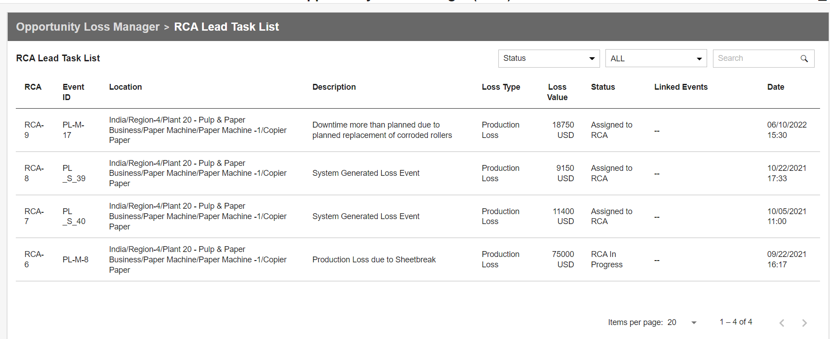
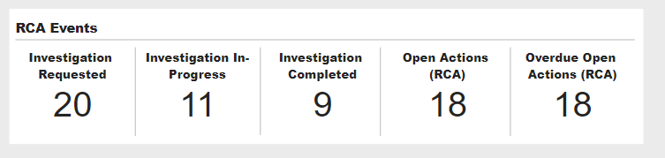
Root Cause analysis: Event details
Visibility of system status
Consistency and standards
Issues:
Proper breadcrumb and No back option
Event details list too big to read
Loss calculation table is too big and horizontal scroll
4. Filter need to table level
Suggestion:
KPI regarding RCA event and details drill down event is needed
Details Event drill needs redesign
Each RCA event listing drill down is needed currently not available.
Keep Static content on sidebar and only actionable accordion can be shown in right section

Slide 10
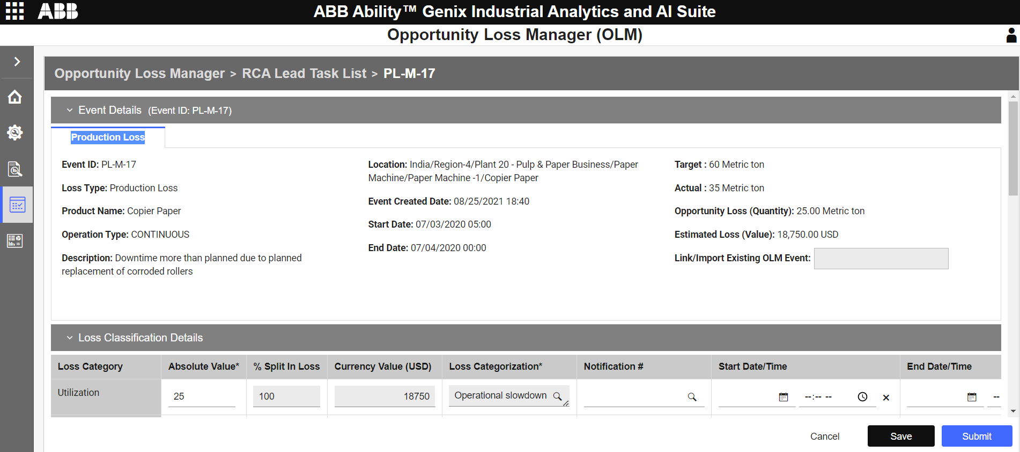
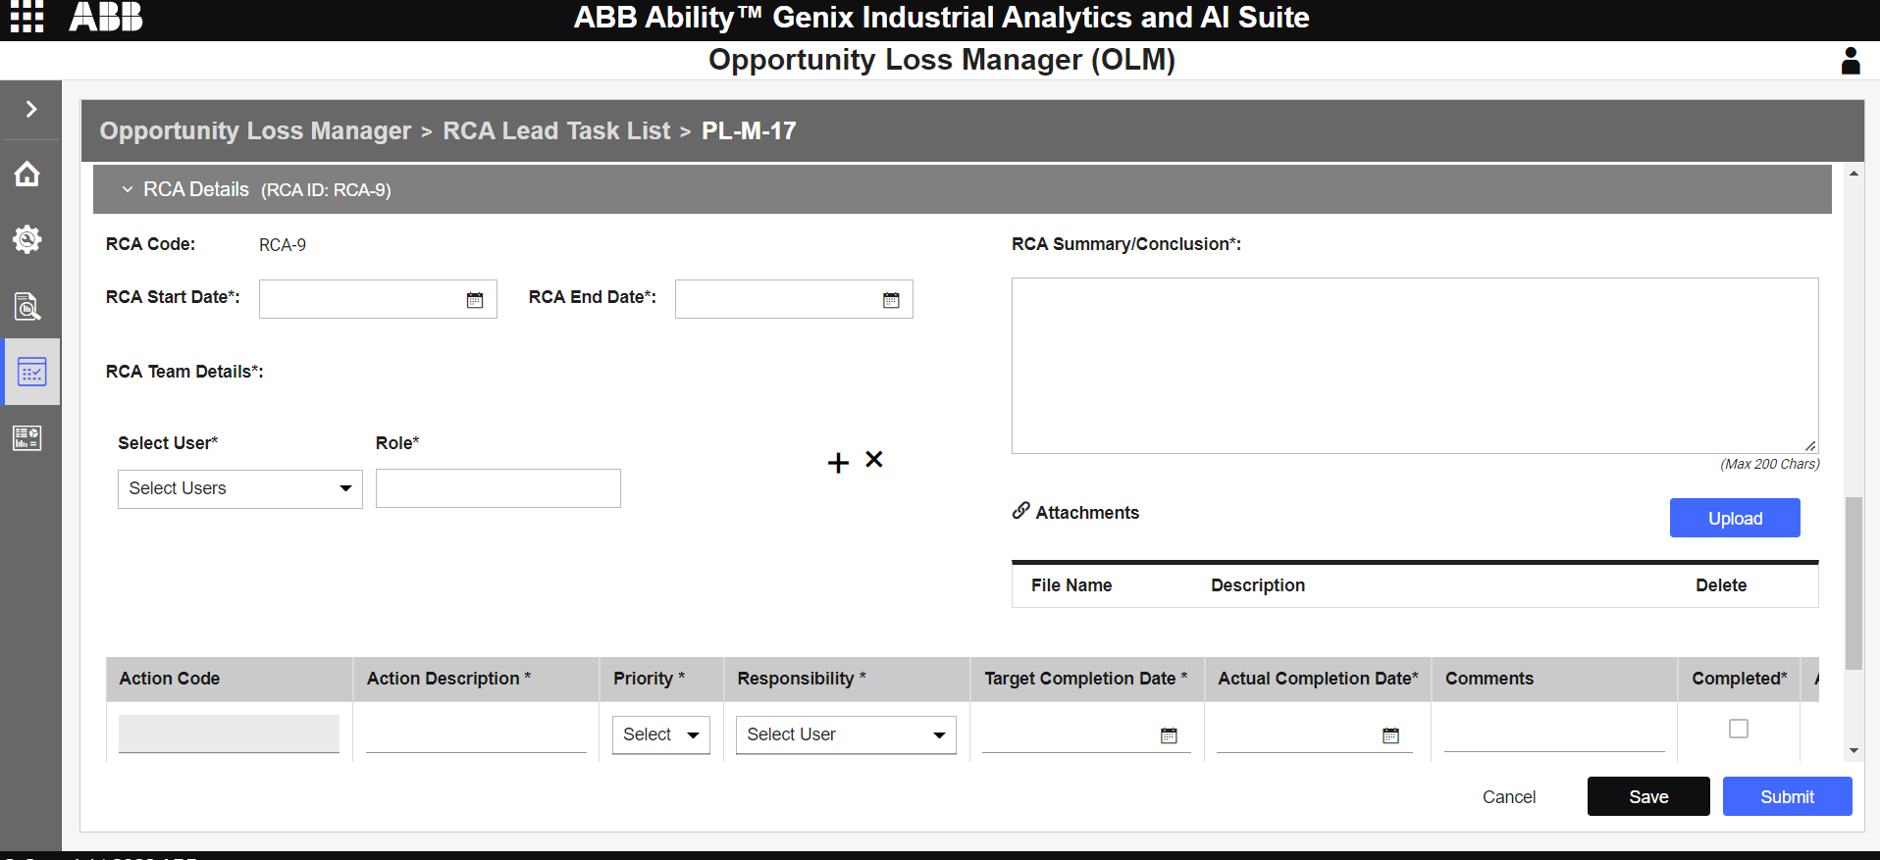
Root Cause analysis: Event details
Visibility of system status
Consistency and standards
Issues:
Proper breadcrumb and No back option
Event details list too big to read
Loss classification table is too big and horizontal scroll
RCA ream details content is not proper in steps
Suggestion:
Page level breadcrumb need to implemented
Keep Static content on sidebar and only actionable accordion can be shown in right section

Slide 11
Important insights to show on dashboard based on Analysis and UX week
Insights page
Global hierarchy
KPI cards on top for total loss , OEE %, Events: approved and Open RCA and process reliability: Reliability
Overall loss tree Flow diagram and with filter based on plant Find proper one and redesign
Insight based on unit : categories and total loses
Combined Chart on Loss categorization and in detail sub loss category.
Overall loss in month wise with category details
chart on events with system and manual events based on monthly
Brief KPI Showcase: total events, review, under implementation, approved. Pending action and completed
Loss by equipment heatmap chart.
Filter: insights filter based on Year, yearly quarterly and monthly.
Each top KPI card on click will have detail drill down insights.
Loss management page
KPI cards on top of OLM Events
Default list of KPI is shown OLM events, events rejected, awaiting approval event approved
Onclick each KPI list all events which is related
Chart on OLM events created
Filter list based on status and Events
Search for RCA task list
Click action event creating an event
Chart on OLM events stages and open RCA

Slide 12
RCA page
KPI cards on top page RCA Events
List Key KPI is shown OLM events, events rejected, awaiting approval event approved
List all task list sent for investigation
Onclick each KPI list all RCA events which is related
Filter list based on status and sub type
Search for RCA task list
Chart on OLM events stages and open RCA

Slide 13
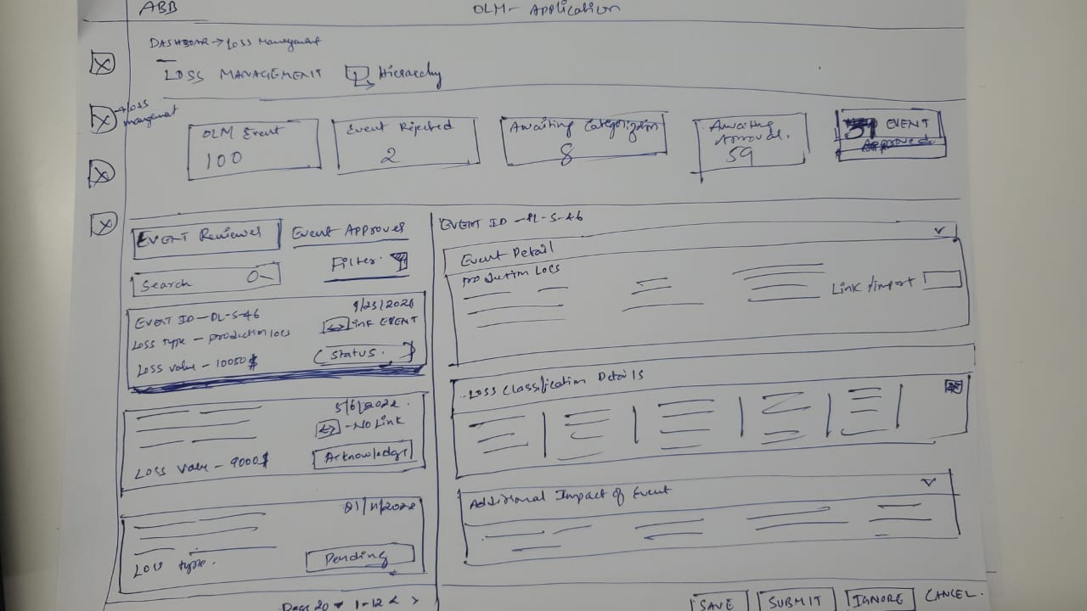
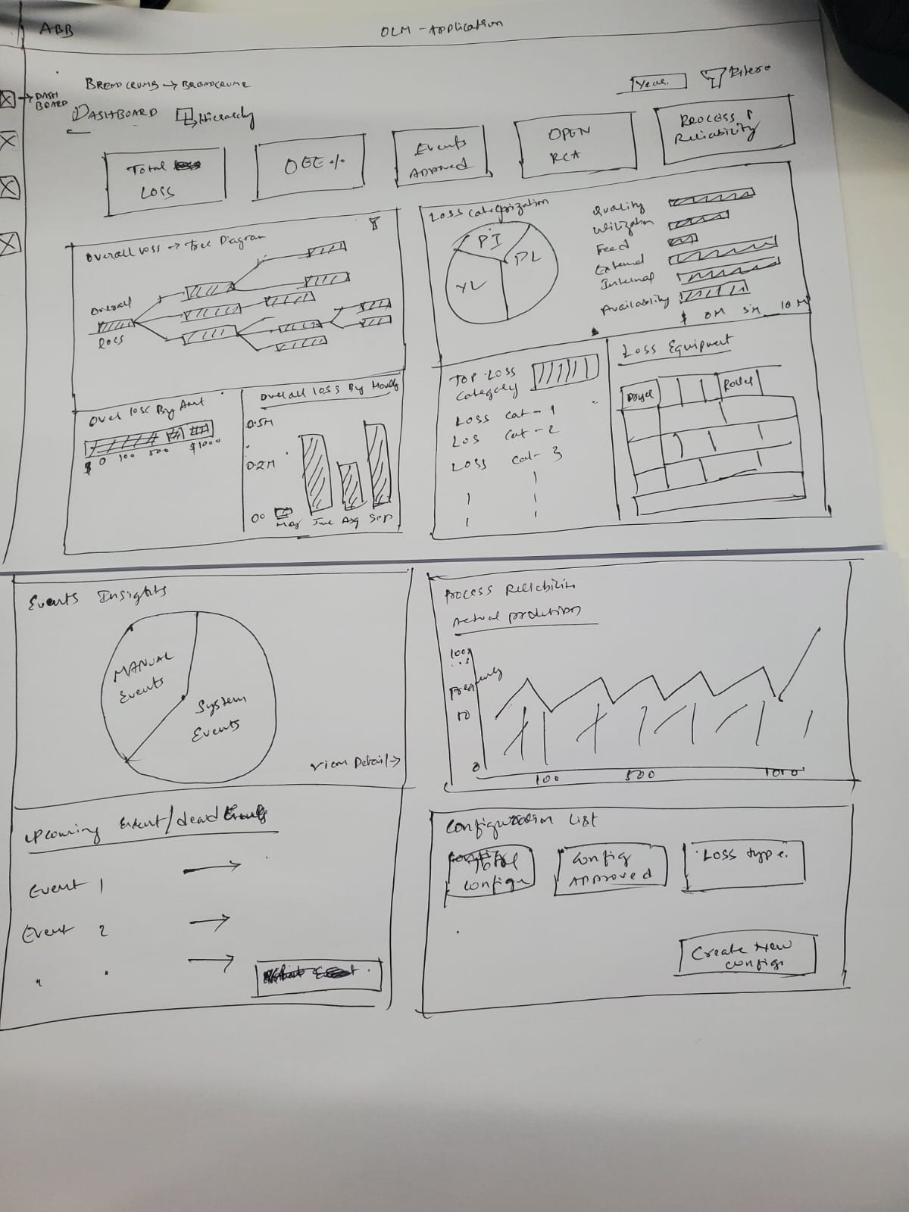
Proposed Sketch for Insights Page: Not finalized will change based on Feedback
Landing page
Loss management page

